Slide 1

Prediction of
Mechanical Failures
Using ML
Exploratory Project by:
Amitesh Vatsa - 20135169
Shreyansh Maurya - 20135152
Sreya Pramod - 20135161
Swayamshu Satyapragyan Swain - 20135156
Ujjwal Bansal - 20135167
Under guidance of:
Dr. Amit Tyagi
Department of Mechanical Engineering, IIT (BHU)

Slide 2
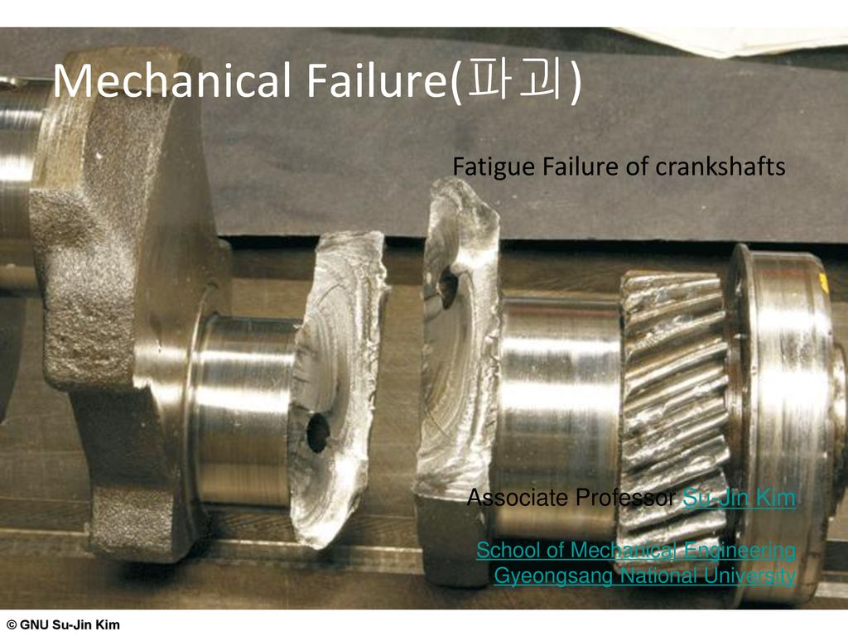

Introduction
It is well recognised how inconvenient it is to have a machine break down. Equipment breakdowns have a direct impact on production. By the time manufacturing resumes, a significant amount of money has been lost.
Reference: https://slideplayer.com/17158517/99/images/slide_1.jpg

Slide 3
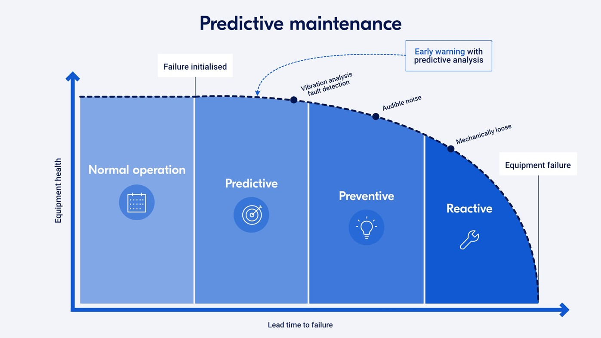
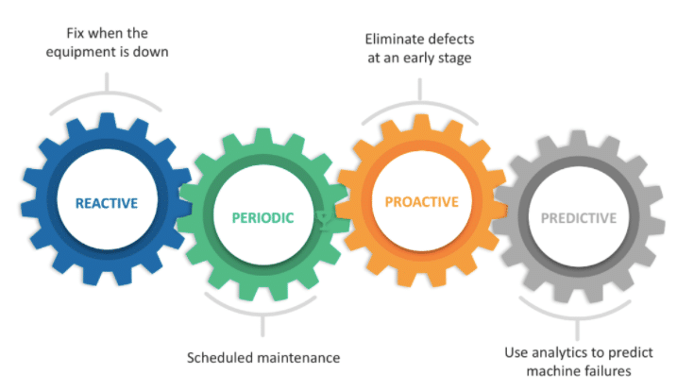
Introduction
Predictive maintenance is a new field in industrial applications that aids in determining the state of in-service equipment and estimating the best maintenance time.
Predictive maintenance based on machine learning saves money and time when it comes to normal or preventative maintenance.
Reference: https://medium.com/ai-techsystems/predictive-maintenance-a257a1645a14 https://research.aimultiple.com/predictive-maintenance-tools/

Slide 4
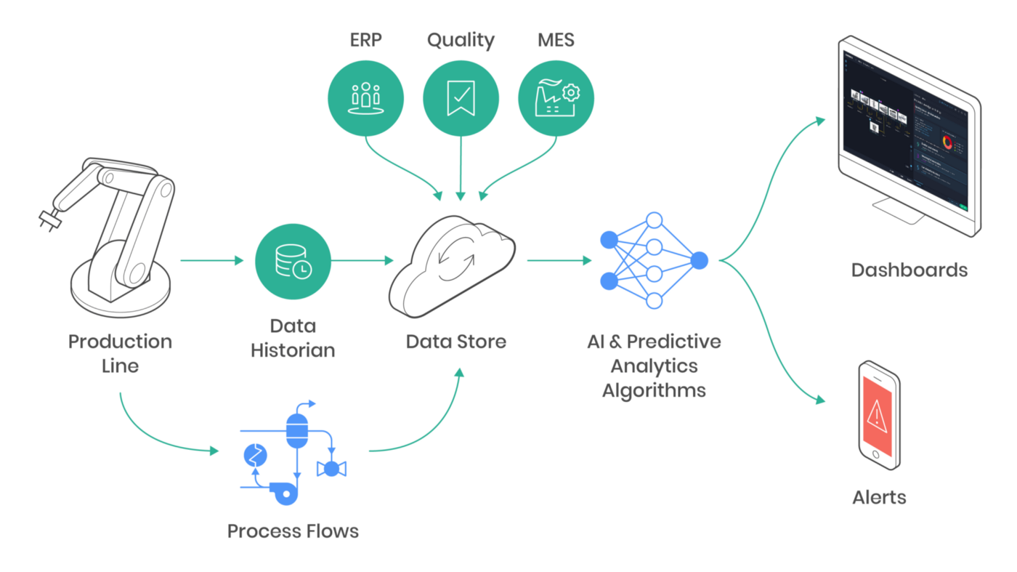
Introduction
In this project, we will make a ML(Machine Learning) model that will continuously monitor data (from power plants, manufacturing units, etc) and provide a smart decision support system, through which, manufacturers can predict the probability of equipment failures.
Reference: https://www.applyscience.it/predictive-maintenance/

Slide 5
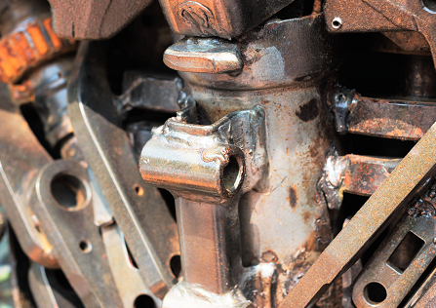
Mechanical Failures
A covered component's unexpected or unforeseen failure is referred to as mechanical failure. It happens as a result of a flaw in the materials or workmanship, and excludes failure due to normal wear or inappropriate machine use and/or maintenance.
Reference: https://www.ceerisk.com/site/services/forensic-engineering/mechanical-failures/

Slide 6
Instances of various Mechanical Failures
We have investigated the root cause of mechanical failures in various numerous situations, including:
Water escape from PRVs (Pressure Reducing Valves)
Failure of steam turbine blades in power plants in several countries
Failure of thrust bearing in a gas turbine
Compressor failure in multiple applications including petrochemical plants
Electric motor malfunction in different applications
Circulation pump seizure
Compression joint separation
Flange seal leakage

Slide 7
Ways to detect Mechanical Failures
Visual Examination evaluates the condition of the failed product in its initial state as well as during disassembly or dissection.
Investigative chemical analysis determines whether the materials of manufacture (alloy, coatings, etc.) meet specification.
Residual analysis, a subset of chemical analysis, looks for contaminants from either manufacturing processes or the environment that may have led to such failure mechanisms as corrosion, stress corrosion cracking, etc.
Fractography employs optical and scanning electron microscopes to identify fracture mechanisms.
Mechanical testing determines the properties of the failed component including tensile properties, ductility, hardness, fatigue properties, and so forth.

Slide 8
Ways to detect Mechanical Failures
Material evaluation examines material structure, grain size, coating thickness and integrity, density, and other characteristics that affect performance, along with identifying anomalies.
We may also use sensors in order to collect various data from the machines, such as, vibration, rotation, pressure
Etc.
In our project we have used sensor values

Slide 9
How to resolve Mechanical Failures
Reactive maintenance solutions are ideal for companies that can't plan ahead of time but need a speedy response when problems happen. However, in an industrial environment, where key gear must be operational at all times, this is far from ideal. Preventing unscheduled breakdowns and downtime is critical in this setting, and planned maintenance solutions can help.
Instead of resolving the mechanical failures, a much more efficient way would be to be able to detect the problems even before it occurs. It is cost efficient and time conserving and the users would be able to make a profit. As a solution to this problem, we introduce machine learning into this scenario.

Slide 10
Using ML to predict Machine Failures
MODEL WE USED

Slide 11
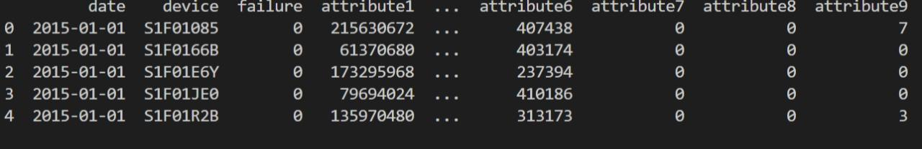
About dataset
This is a dataset containing data collected from various sensors, installed in our machines. Here, the attributes depict the sensor values. We have a total of 9 attributes. The failure column depicts the output probability of machine failure. Here, 0 means failure does not occur and 1 means failure detected.

Slide 12
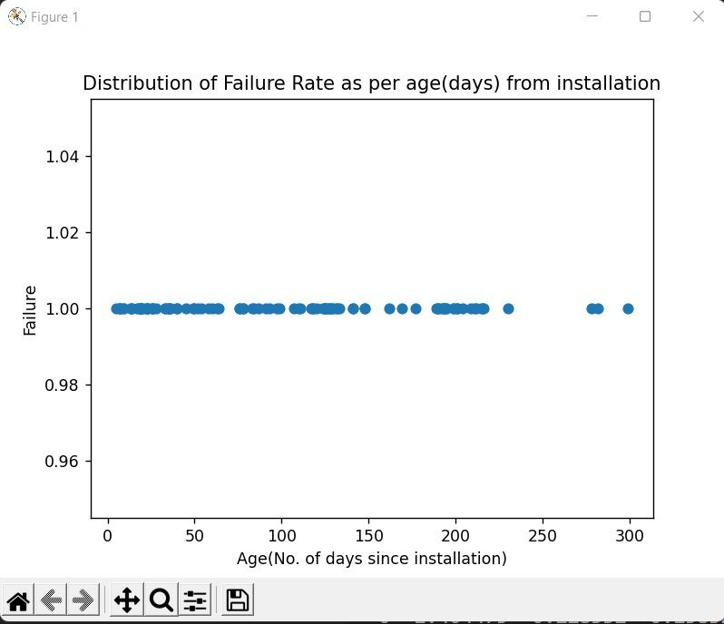
Results

Slide 13
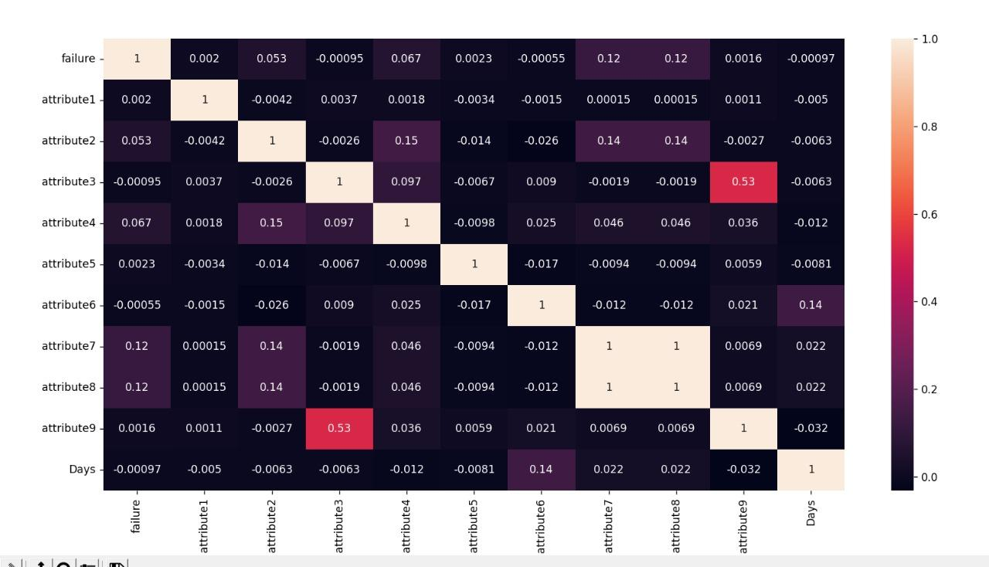
Results

Slide 14
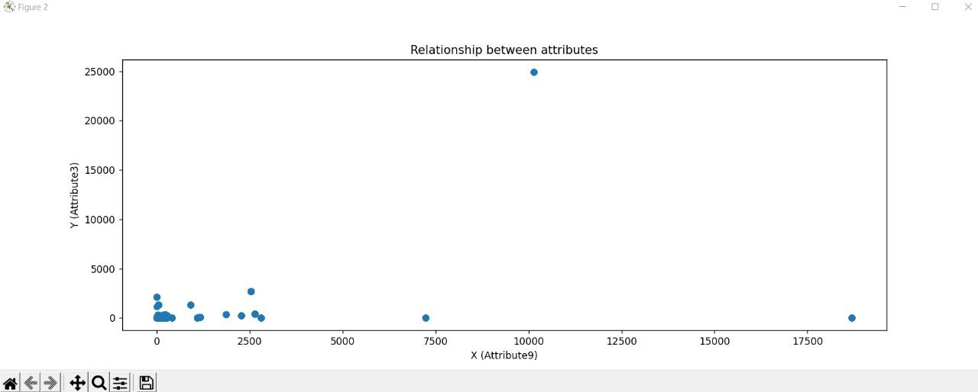
Results

Slide 15
Accuracy on 50 percent training
Result
Accuracy on 80 percent training

Slide 16
WHAT WE LEARNT
We learnt about gaussian naive bayes model
We learnt about how training the model with different sizes of dataset affect accuracy.
We learnt about removing unuseful column in the dataset
We learnt about usefulness of this model for detecting failure.
Also while making this project we learnt about different model as well.

Slide 17
Conclusion
Predictive models can now be used to estimate the likelihood of failure. This provides us various advantages.
The ability to plan maintenance in such a way that losses are minimized.
To improve inventory optimization. Instead of retaining a large inventory of spare components, it is possible to keep only those that will be needed in the near future.
The capacity to improve products is perhaps the most significant advantage these models provide an OEM(Original Equipment Manufacturer).

Slide 18
Thank You

